Slide 1

DSML May Cohort Group 4
STROKE PREDICTION
Review of ML models for stroke prediction

Slide 2
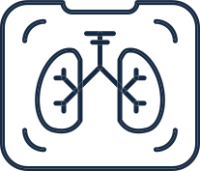







STROKE PREDICTION
Presentation Outline
Today's Discussion
Business Question
Data Collection
Preprocessing
Model Creation and Evaluation
Results
Conclusion and Future Improvements
Additional value to business

Slide 3
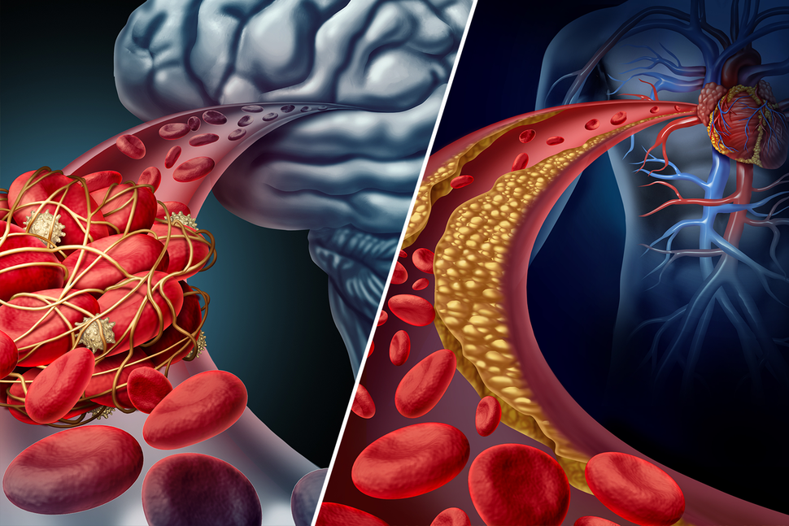

STROKE PREDICTION
Business Question
Our aim is to assist insurance start-up to find a model that best predicts the likelihood of their new clients experiencing stroke.
In addition, we seek to identify a health indicator that, if improved, could help to prevent stroke.

Slide 4
STROKE PREDICTION
Data Collection
5,110 x 12
~5%
Real patient data*
Suffered from stroke
Features include: ['gender', 'age', 'hypertension', 'heart_disease', 'ever_married', 'Residence_type', 'avg_glucose_level', 'bmi', 'work_type_Never_worked', 'work_type_Private', 'work_type_Self-employed', 'work_type_children'] Target: stroke
* https://www.kaggle.com/fedesoriano/stroke-prediction-dataset

Slide 5
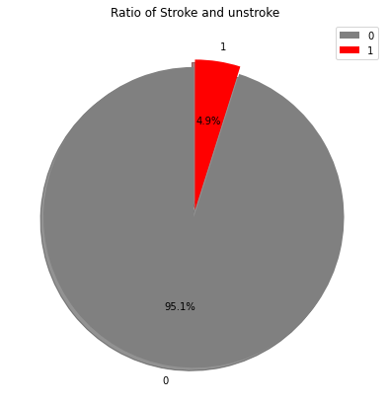
STROKE PREDICTION
What were the challenges
Data
Preprocessing
Imbalanced dataset (only 5% of patients experienced stroke)
Missing data (BMI, Smoking)
Outliers
How did we resolve them
Under-sampling, Oversampling, tweaking parameters
Dropping values (Smoking - 1/3rd missing - dropped), filling gaps with median values (BMI - 201 entries (4% of total but 20% of stroke))
Removing Outliers

Slide 6
STROKE PREDICTION
Workflow
Without
Sampling
Sampling
Under Sampling
Over
Sampling
Tweaking
Parameters
Baseline
GridSearchCV
Logistic
Regression
KNN
Decision Tree

Slide 7
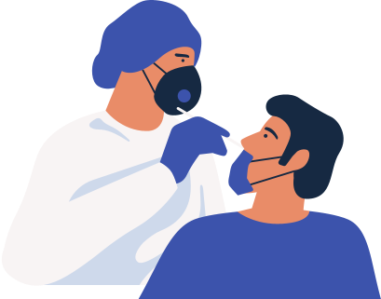
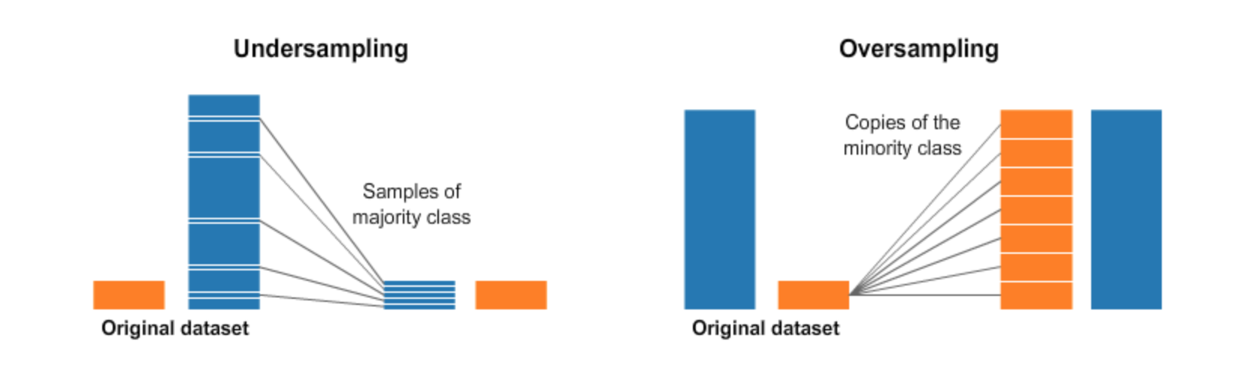
STROKE PREDICTION
Model Creation & Evaluation
Identifying Issues

Slide 8
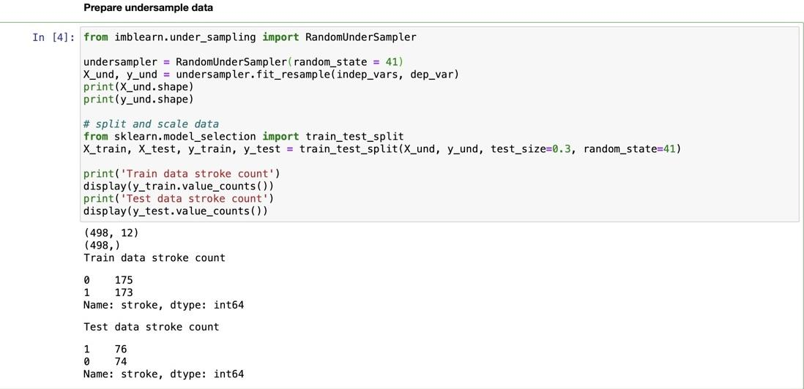
STROKE PREDICTION

Slide 9
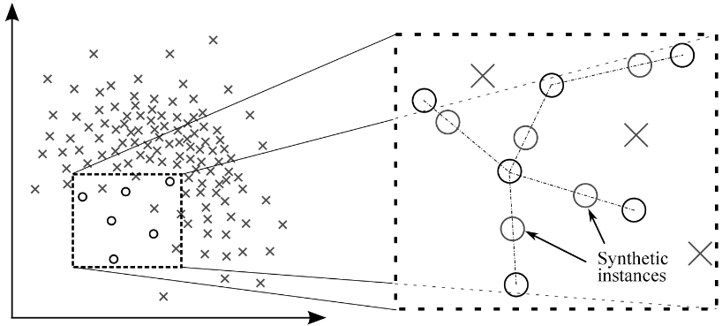
STROKE PREDICTION
SMOTE
Synthetic Minority Over sampling Technique (SMOTE) algorithm applies KNN approach where it selects K nearest neighbors, joins them and creates the synthetic samples in the space. The algorithm takes the feature vectors and its nearest neighbors, computes the distance between these vectors. The difference is multiplied by random number between (0, 1) and it is added back to feature. SMOTE algorithm is a pioneer algorithm and many other algorithms are derived from SMOTE.

Slide 10
STROKE PREDICTION
Model Creation & Evaluation
Identifying Issues

Slide 11
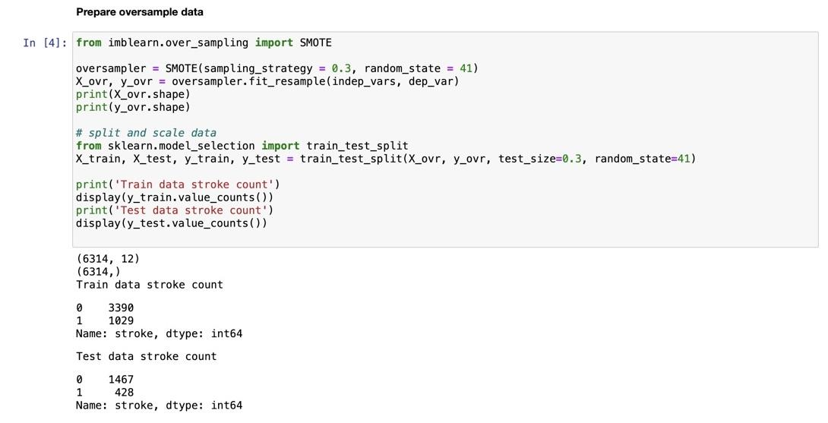
STROKE PREDICTION

Slide 12
STROKE PREDICTION
Hyperparameters
Logistic Regression:
KNearestNeighbors:
DecisionTree:
RandomForest
XGBoost
C
max_iter
class_weight
n_neighbors
weights
max_depth
max_leaf_nodes
class_weight
max_depth
max_leaf_nodes
class_weight
gamma
subsample
max_depth

Slide 13
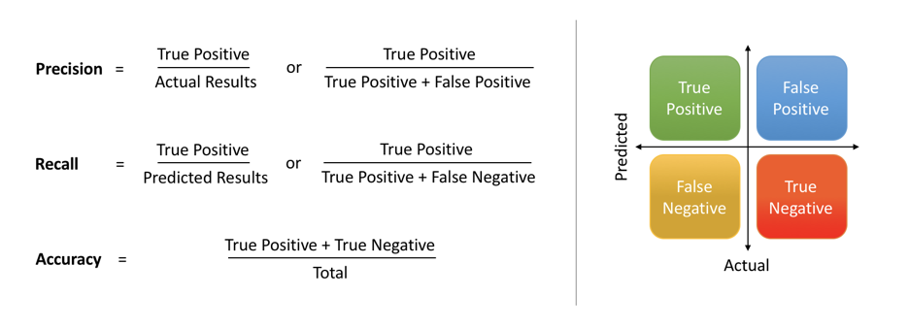
STROKE PREDICTION
Results
High chance of getting stroke correctly identified
Incorrectly identified as having high chance of stroke
Incorrectly identified as not having high chance of stroke
Correctly identified as not having high chance of stroke
Since we are dealing with a life threatening illness, it is perceived better, if we incorrectly identify a person having a high chance of getting a stroke, than miss one with high chance of getting one.
Therefore higher Recall metric is preferred (i.e. False Negative as little as possible)

Slide 14
STROKE PREDICTION
Results
 |  | Undersampling | Oversampling | Tweaking
Logistic | Precision | 0.72 | 0.71 | 0.17
 | Recall | 0.76 | 0.38 | 0.82
KNN | Precision | 0.78 | 0.68 | 0
 | Recall | 0.75 | 0.71 | 0
Decision Tree | Precision | 0.75 | 0.77 | 0.16
 | Recall | 0.74 | 0.72 | 0.57
In cases where class distribution is skewed, the accuracy metric is biased and not preferable, therefore we look into Recall and Precision metrics.

Slide 15
STROKE PREDICTION
Results
 |  |  | Undersampling |  | Oversampling |  | Tweaking |  | Baseline
Logistic | TP | FP | 58 | 22 | 161 | 67 | 49 | 232 | 0 | 0
 | FN | TN | 18 | 52 | 267 | 1400 | 11 | 730 | 60 | 962
KNN | TP | FP | 67 | 16 | 304 | 134 | 0 | 0 | 0 | 0
 | FN | TN | 19 | 58 | 124 | 1333 | 60 | 962 | 60 | 962
Decision Tree | TP | FP | 56 | 19 | 308 | 93 | 34 | 182 | 0 | 2
 | FN | TN | 20 | 55 | 120 | 1374 | 26 | 780 | 60 | 960

Slide 16
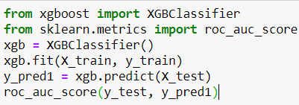
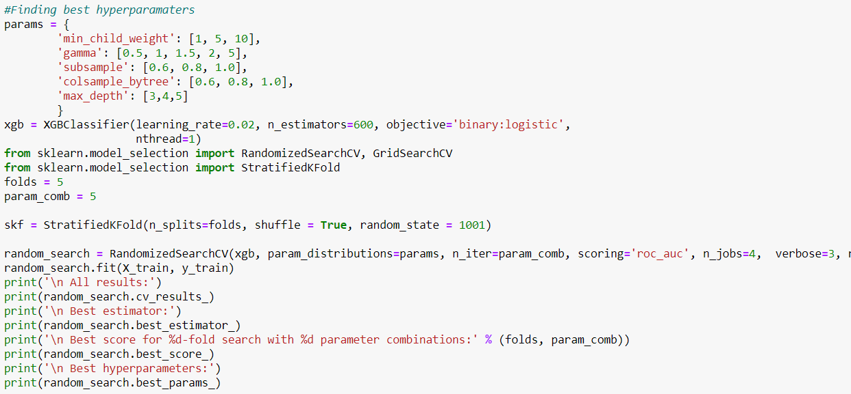
STROKE PREDICTION
Xgboost & Pruning
5 Parameters
5-fold search

Slide 17
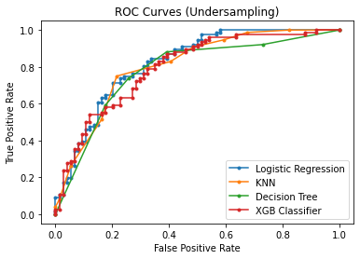
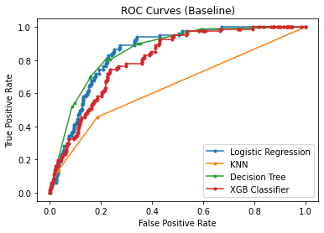
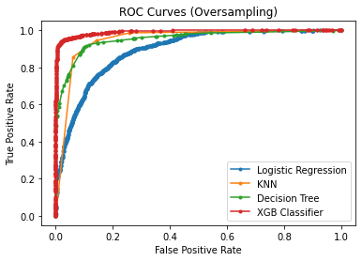
STROKE PREDICTION
ROC Curves
Performance

Slide 18
STROKE PREDICTION
Underfitting vs Overfitting
In order to improve prediction accuracy, we need to tune hyper parameters of the learning algorithms.
To choose the right hyper parameters, we need to understand how the model is performing.
Training Score | Testing Score
Poor | Poor | Underfit
Good | Poor | Overfit
Good | Good | Done

Slide 19

STROKE PREDICTION
Larger and Balanced Sample Required
Conclusion and
future improvements
More features should be observed
More trials on hyperparameters tuning
More models trial

Slide 20
STROKE PREDICTION
Can the machine learning model add further values to the business?
It certainly can !

Slide 21
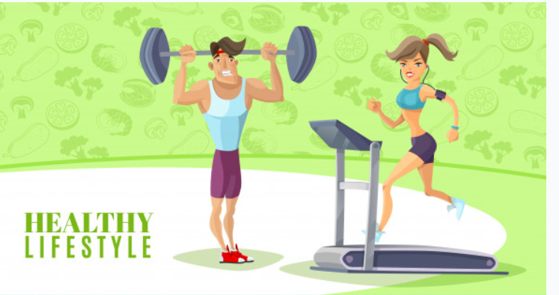

STROKE PREDICTION
Healthy People
Less likely to make a claim
Unhealthy Lifestyle
Increase the chance of making a claim
Offer incentives to clients to improve their health !

Slide 22
STROKE PREDICTION
Question 1:
Which is the most important health indicator clients should improve in order to improve their health (i.e. reduce chance of stroke)?
Question 2:
Given all other conditions remain the same, can improvement on a single health indicator improve health (i.e. reduce chance of stroke)?
The machine learning model has the answers already !

Slide 23
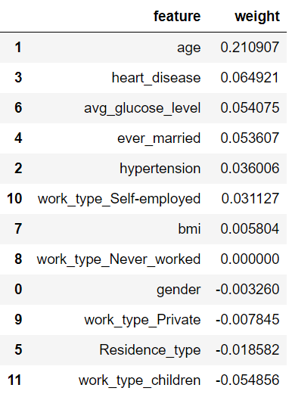
STROKE PREDICTION
Question 1: Which indicator?
The coefficients tell us how much each feature contribute to the output.

Slide 24
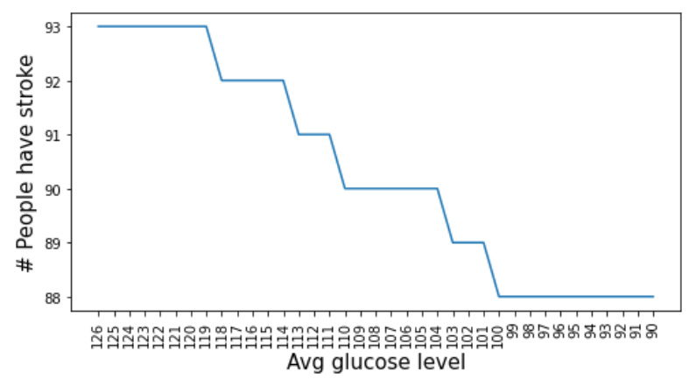
STROKE PREDICTION
Question 2: Reduce chance of stroke by only improving glucose level?
Less than 126 mg/dL is considered ok. Non-diabetic people expect to be 80-99 mg/dL before meal.

